Slide 1
Overview of BI and role of DW in BI
Business Intelligence & Why is it popular?
Business Intelligence Steps
Business Intelligence Cycle
Example Scenarios
State of Business Intelligence
Business Intelligence Tools
Role of Data Warehouse in BI
Characteristics of data in DW
Notes:
1

Slide 2
Popular Quote
"The secret of business is to know something that nobody else knows."
- Aristotle Onassis

Slide 3
Demand Oriented Questions
What is the effectiveness of various government programs?
What is the cost effectiveness of various programs?
What is the breakdown of the client base by program, service, demographic makeup?
What is the adherence of the programs to state wise with respect to regulations?
What are the administrative costs of running district, state, and region based programs?
so on
Notes:
Most of the organizations today are faced with an almost overwhelming and demand oriented set of questions.

Slide 4
Information
availability
Knowledge Gap
Analytical
Potential
Notes:
The slide shows the Gartner report. If you carefully view the graph shown on the slide, much of the data to answer these questions exists and more is available but there is a growing gap present in the ability of organizations to analyze it.

Slide 5
Challenges to accessing data in answering questions
Multiple sources of data and reporting systems
Difficulty in locating and addressing information
Unreliable information
Pressures to lower costs and improve services
Information requests take days or weeks to fulfill
Re-keyed data ensuring errors creep into results
Notes:
So what are the challenges for data access to answer these so called demand oriented questions?

Slide 6
Business intelligence?
Business Intelligence means using your data assets to make better business decisions.
BI is able to turn the data into useful information
Assist to take more strategic decisions
Minimizes operating costs
Notes:
The techniques of BI are useful to answer these questions. Business intelligence involves the gathering, management, and analysis of data for the purpose of turning that data into useful information which is then used to improve decision making. Organizations can then make more strategic decisions about how to administer clients and programs. These practices can also reduce operating costs through more effective financial analysis, risk management, and fraud management

Slide 7
Accounting systems
Basic ‘sort and report’
Administrative and
accounting systems to
Automate financial
Reporting processes
Operations systems
Integrated operations
and planning systems
providing centralized
business controls and
enterprise transaction
processing
Intelligence systems
Discovery and analysis
system used to enhance
strategic and tactical
decisions
Notes:
Business Intelligence represents a fundamental shift in the purpose, objective and use of information

Slide 8
Business Intelligence Solutions are...
"...the combination of data warehouse and end-user data access and analysis tools..."
"...an investment in information technology that can assist governments in managing limited fiscal resources..."
"... solutions which enable an end-user to quickly and easily analyze organizational data to make intelligent decisions..."
"... systems that put information in the hands of end-users..."

Slide 9
Business Intelligence solutions start with data warehouses and data marts

Slide 10
Notes:
Industry leaders agree that data warehousing is a process, a journey and takes a commitment.

Slide 11
Business Intelligence
“Business Intelligence (BI) software systems allow companies to make more informed and faster decisions by helping them to access and analyze data.”
Notes:
11
Relatively new term but the it is synonymous with a range of applications that have been around for years. That means BI is nothing but An umbrella term that combines architectures, tools, databases, applications, and methodologies by building a system which basically assist the organizations to make more informed and faster decisions.

Slide 12
Business Intelligence
Business Intelligence is the process of transforming data into information and through discovery transforming that information into knowledge” - Gartner Group
It is the conversion of data into information in such a way that the business is able to analyse the information to gain insight and take action
Sometimes used synonymously with the information available in an enterprise for making strategic decisions
Business Intelligence is a discipline of developing information that is conclusive, fact-based and actionable.”
Notes:
12

Slide 13
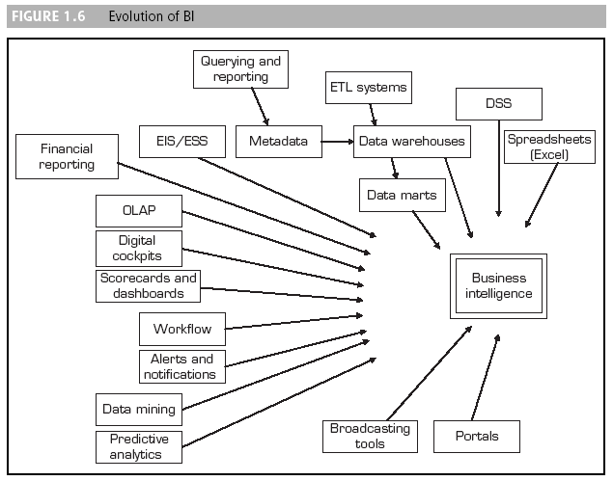
Business Intelligence Evolution
Notes:
The slide shows evolution of BI.

Slide 14
Why Business Intelligence Popular?
Business Intelligence gives companies ability to discover and utilize information they already own, and turn it into the knowledge that directly impacts corporate performance”
Tactical Description:
Trends, patterns, clustering, planning, cause & effect
Why? How? When? What?
Decision-making support
Reporting and QA
Forecasting
“Human-sized” reports
Notes:
14

Slide 15
Fill in the blanks…
“Our company has tons of _______,
but no real ____________!!!”
“How you gather, manage, and use information will determine whether you win or lose.”
Bill Gates – Business at the Speed of Thought
Notes:
15

Slide 16
Business Intelligence
Various Steps:
Gathering Data
Organizing and Storing Data
Analysis
Dissemination of Results
Decision Making and Action
Notes:
16

Slide 17
The BI Cycle
Business
intelligence
Notes:
17

Slide 18
Example Scenario – I
A local bank branch manager views a report generated by a database application at the end of a workday and decides to order more cash from the central vault, due to the low cash level in the local branch shown in the report. The data about cash was gathered and organized in a database, analyzed into a report that was disseminated to the manager who then made a decision based on it.
Notes:
18

Slide 19
Example Scenario II
A CEO of a large bank views a comprehensive analysis report describing the performance of each branch for the past TEN years and makes a decision to close a particular bank branch. The data about branches was gathered and organized in a database, analyzed into a report that was disseminated to the CEO who then made a decision based on it.
Notes:
19

Slide 20
BI Questions
What happened?
What were our total sales this month?
What’s happening?
Are our sales going up or down, trend analysis
Why?
Why have sales gone down?
What will happen?
Forecasting & What If Analysis
What do I want to happen?
Planning & Targets
Notes:
20

Slide 21
Where is Business Intelligence applied?
Operational Efficiency
Customer Interaction
ERP Reporting
KPI Tracking
Product Profitability
Risk Management
Balanced Scorecard
Activity Based Costing
Global Sourcing
Logistics
Sales Analysis
Sales Forecasting
Segmentation
Cross-selling
CRM Analytics
Campaign Planning
Customer Profitability
21
Notes:
21
BI can be applied within the business or in those areas that reach outside the business. Here are just some examples.
Companies spend millions on ERP and find they are unable to report or analysis their data
Balanced scorecard provides a consolidated view of the business
Segmentation – cutting the data by the key dimension. Richard will demonstrate some examples of this

Slide 22
A Framework for Business Intelligence (BI)
BI architecture
Data warehouse
Business analytics
Performance management (BPM)
Notes:
The architecture of BI consists of three components. They are Data Warehouse, Business Analytics and Performance management. In this course we are discussing only data warehouse component only.

Slide 23
Data Warehousing
Need for Data Warehousing
Integrated, company-wide view of high-quality information.
Separation of operational and analytical systems and data.
Data Warehouse
A foundation of a comprehensive business intelligence system
Notes:
23

Slide 24
Business Intelligence Software
Integration of
OLAP multi-dimensional technology
Relational database technology
Web technology
Scalability for warehousing
Flexibility, performance and business views
Web deployment
Notes:
24

Slide 25
Business Intelligence Tools
Software that enables business users to see and use (analyze) large amounts of complex data.
Database Related
Data Storage Software (DBMS)
Query and Reporting Tools
Data Warehousing Related
Data Warehouse/ Data Mart Creation Tools
OLAP Tools
Data Mining Related
Data Mining Tools
Other Special Purpose Tools
Notes:
25

Slide 26

Source Systems
Executives, Managers, and Business Analysts
Client Data
Custom
Application
How is my business really doing?
ERP
Packaged
Application
Custom
Application
Notes:
26

Slide 27
Source Systems
Executives, Managers, and Business Analysts
Client Data
Custom
Application
Data
Warehouse
OLAP
Cube
ERP
OLAP
Cube
Data Warehousing and OLAP
Key Benefits
Packaged
Application
VeryFast
Very flexible
All potential queries available
Offloads queries from production system
Provides consistent data model
Custom
Application
Notes:
27

Slide 28
State of Business Intelligence
Robust, scaleable, web deployable BI technologies are available
Problems are likely to lie in data complexity, process and people
Successful implementation demands very close working between the business and the system providers
Choosing products is as hard as ever
There’s no such thing as a green field site (OLAP, Query & Reporting, RDBMS, ETL, Data Mining)
ERP vendors are offering BI
28
Notes:
28
And with these types of application areas, coupled with the adhoc, flexible nature of BI, having clear sight of your business goals is very important.
Although the technology integrates data sources the old problems still exist with data quality & complexity

Slide 29
Types of Information used in BI?
What types of information does BI consider?
Customer information
Competitors
Business partners
Economic
Environmental
Internal operations
This information is used to make effective and good quality business decisions

Slide 30
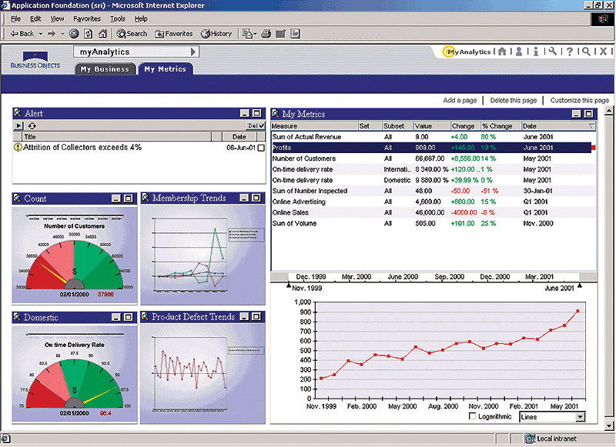
Example BI Tools

Slide 31
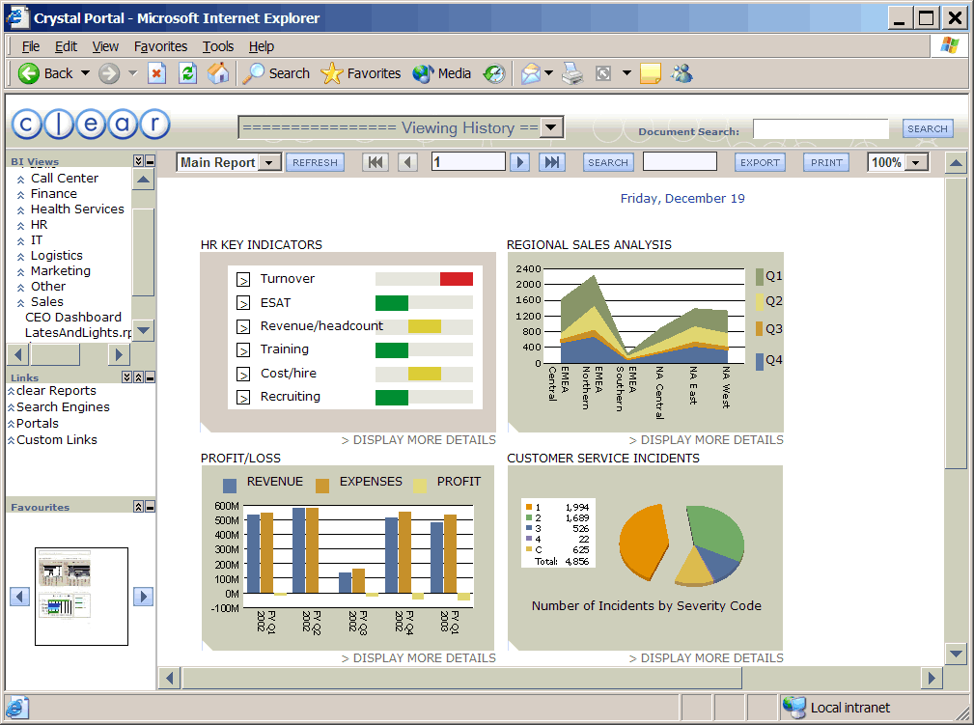
Example BI Tools

Slide 32
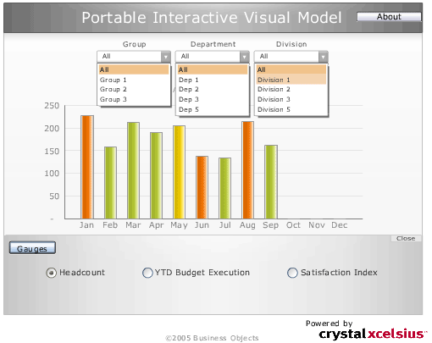
Example BI Tools

Slide 33
Business Intelligence
Business Intelligence is the process of transforming data into information and through discovery transforming that information into knowledge” - Gartner Group
It is the conversion of data into information in such a way that the business is able to analyse the information to gain insight and take action
Sometimes used synonymously with the information available in an enterprise for making strategic decisions
Business Intelligence is a discipline of developing information that is conclusive, fact-based and actionable.”

Slide 34
Business Intelligence
DATA
Notes:
Data
Known facts that can be recorded and stored on computer media (raw facts).

Slide 35
Business Intelligence
INFORMATION
DATA
Notes:
Information
Data processed into a form that has a meaning and is useful.

Slide 36
Business Intelligence
KNOWLEDGE
INFORMATION
DATA
Notes:
Data
Known facts that can be recorded and stored on computer media (raw facts).
Knowledge
Knowledge is based on information and it implies responsibility and commitment to a decision.

Slide 37
Business Intelligence
DECISION
KNOWLEDGE
INFORMATION
DATA
Notes:
Decision
Ignites action based on knowledge.

Slide 38
Motivation: “Necessity is the Mother of Invention”
Data explosion problem
Automated data collection tools and mature database technology lead to tremendous amounts of data stored in databases, data warehouses and other information repositories
How to satisfy users when they demand ?
Data warehousing and on-line analytical processing
Extraction of interesting knowledge (rules, regularities, patterns, constraints) from data in large databases
Notes:
At one side due to rapid development of technologies, data is growing at rapid rate and at the same time users are expecting a sophisticated information.
The solution is to uncover the hidden information.

Slide 39
Characteristics of data in DW
DW can be viewed as an informational system with the following attributes
It is a database designed for analytical tasks
using data from multiple applications.
Supports small no. of users with long
interactions.
Usage is read-intensive.
Content is periodically updated (mostly
additions)
Contains a few large tables

Slide 40
What are the users saying...
Data should be integrated across the enterprise
Summary data has a real value to the organization
Historical data holds the key to understanding data over time
What-if capabilities are required

Slide 41
What is Data Warehousing?
A process of transforming data into information and making it available to users in a timely enough manner to make a difference
[Forrester Research, April 1996]
Information
Data

Slide 42
Benefits of DW
Access to a wide variety of data
Results can be presented in a variety of formats (reports, graphs)
Enhances the value of operational business applns.
Cost of product introduction comes down with target marketing campaigns.
Better decisions at low cost.
Clear picture on asset and liability mgmt, enterprise wide purchasing and inventory patterns.
Maintain good relations with customers by knowing their requirements.

Slide 43
Limitations of DW
Can not create additional data.
If data quality is poor then decision will be inaccurate.
Notes:
DW collects and report data that already exists.
If an organization wishes to analyze the customers by zip code but addresses are not captured then it is not possible.

Slide 44
Risks of DW
Organizational: risks relate to project team
Technological: selection of technology, poor scalability of architecture.
Project Mgmt: scale and scope of projects are ill-defined.
Data and Design: poor quality of data, unreliable data, improper collection of data.
Notes:
Project team structure and composition or to the culture of the enterprise
Technological: these risks relate to the planning, selection and use of warehousing technologies. Poor scalability of architectures, insufficient skills of implementers.

Slide 45
Why Separate Data Warehouse?
Performance
Op dbs designed & tuned for known txs & workloads.
Complex OLAP queries would degrade perf. for op txs.
Special data organization, access & implementation methods needed for multidimensional views & queries.

Slide 46
Why Separate Data Warehouse?
Function
Missing data: Decision support requires historical data, which op dbs do not typically maintain.
Data consolidation: Decision support requires consolidation (aggregation, summarization) of data from many heterogeneous sources: op dbs, external sources.
Data quality: Different sources typically use inconsistent data representations, codes, and formats which have to be reconciled.

Slide 47
Data Warehouse Evolution
STAGE 1
REPORTING
WHAT happened?
STAGE 2
ANALYZING
WHY did it happen?
STAGE 3
PREDICTING
WHY will it happen?
STAGE 4
OPERATIONALIZING
WHAT IS Happening?
STAGE 5
ACTIVE WAREHOUSING
MAKING it happen!
Primarily Batch
Increase in Ad Hoc Queries
Analytical Modeling
Grows
Continuous Update &
Time Sensitive Queries Become Important
Event Initiated Actions
Take Hold
Batch Ad Hoc Analytics
Continuous Update/Short Queries Event Initiated Actions

Slide 48
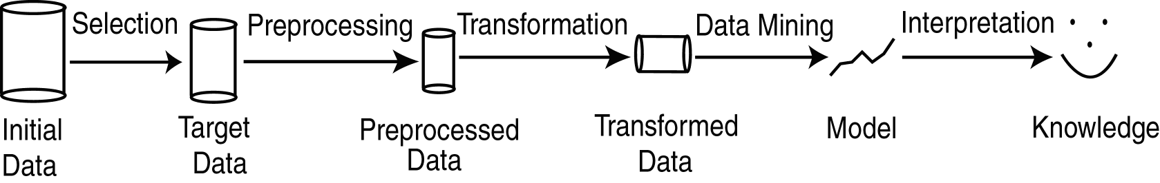
KDD Process
Selection: Obtain data from various sources.
Preprocessing: Cleanse data.
Transformation: Convert to common format. Transform to new format.
Data Mining: Obtain desired results.
Interpretation/Evaluation: Present results to user in meaningful manner.

Slide 49
Data Mining: A KDD Process
Knowledge
Data mining: the core of knowledge discovery process.
Pattern Evaluation
Data Mining
Task-relevant Data
Data Warehouse
Selection
Data Cleaning
Data Integration
Databases

Slide 50
Steps of a KDD Process
Learning the application domain:
relevant prior knowledge and goals of application
Creating a target data set: data selection
Data cleaning and preprocessing: (may take 60% of effort!)
Data reduction and transformation:
Find useful features, dimensionality/variable reduction, invariant representation.
Choosing functions of data mining
summarization, classification, regression, association, clustering.
Choosing the mining algorithm(s)
Data mining: search for patterns of interest
Pattern evaluation and knowledge presentation
visualization, transformation, removing redundant patterns, etc.
Use of discovered knowledge

Slide 51
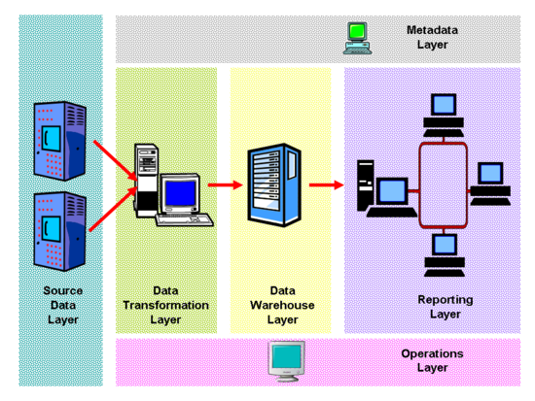
Warehouse Architecture

Slide 52
Warehouse Architecture
Any electronic repository of information that contains data of interest for management use or analytics

Slide 53
Warehouse Architecture
Extracts data from the source locations and transforms it to the target format and structure

Slide 54
Warehouse Architecture
Normally a relational database designed to hold large amounts of information for data analysis

Slide 55
Warehouse Architecture
Business intelligence tools, Executive information systems, OLAP, and data mining applications

Slide 56
Warehouse Architecture
Informs operators about Data Warehouse system status and contains information about the data stored within, such as table & column names, descriptions, etc.

Slide 57
Warehouse Architecture
Operations requiring loading, processing, and manipulating data from the DW. Covers user management, security, and capacity restrictions as well.

Slide 58
Reporting Tools
Andyne Computing -- GQL
Brio -- BrioQuery
Business Objects -- Business Objects
Cognos -- Impromptu
Information Builders Inc. -- Focus for Windows
Oracle -- Discoverer2000
Platinum Technology -- SQL*Assist, ProReports
PowerSoft -- InfoMaker
SAS Institute -- SAS/Assist
Software AG -- Esperant
Sterling Software -- VISION:Data

Slide 59
Other Warehouse Related Products
Data extract, clean, transform, refresh
CA-Ingres replicator
Carleton Passport
Prism Warehouse Manager
SAS Access
Sybase Replication Server
Platinum Inforefiner, Infopump

Slide 60
Warehouse Products
Computer Associates -- CA-Ingres
Hewlett-Packard -- Allbase/SQL
Informix -- Informix, Informix XPS
Microsoft -- SQL Server
Oracle -- Oracle7, Oracle Parallel Server
Red Brick -- Red Brick Warehouse
SAS Institute -- SAS
Software AG -- ADABAS
Sybase -- SQL Server, IQ, MPP

Slide 61
Warehouse Server Products
Oracle
Informix
Online Dynamic Server
XPS --Extended Parallel Server
Universal Server for object relational applications
Sybase
Adaptive Server 11.5
Sybase MPP
Sybase IQ

Slide 62
Warehouse Server Products
Red Brick Warehouse
Tandem Nonstop
IBM
DB2 MVS
Universal Server
DB2 400
Teradata

Slide 63
Data Warehouse
W.H. Inmon, Building the Data Warehouse, Second Edition, John Wiley and Sons, 1996
W.H. Inmon, J. D. Welch, Katherine L. Glassey, Managing the Data Warehouse, John Wiley and Sons, 1997
Barry Devlin, Data Warehouse from Architecture to Implementation, Addison Wesley Longman, Inc 1997

Slide 64
Useful URLs
Ralph Kimball’s home page
http://www.rkimball.com
Larry Greenfield’s Data Warehouse Information Center
http://pwp.starnetinc.com/larryg/
Data Warehousing Institute
http://www.dw-institute.com/
OLAP Council
http://www.olapcouncil.com/

